Slide 1

AI Tools for Content Creation and Media
(أدوات الذكاء الاصطناعي لإنشاء المحتوى والإعلام)

Slide 2
Outline
AI Video Generator (مولد فيديو بالذكاء الاصطناعي)
AI Audio Enhancement (تحسين الصوت بالذكاء الاصطناعي)
AI-Powered Talking Avatar Platform (منصة أفاتار ناطق بالذكاء الاصطناعي)
AI Presentation Creator Online (منشئ العروض التقديمية عبر الإنترنت)
AI Song Generation (توليد الأغاني بالذكاء الاصطناعي)
Creative AI Platform (منصة إبداعية بالذكاء الاصطناعي)
Social Media Caption Generator (مولد تسميات وسائل التواصل الاجتماعي)
AI Presentation Creator Offline (منشئ عروض تقديمية دون اتصال)
Turn Python Scripts into Apps & Dashboards (تحويل سكربتات بايثون إلى تطبيقات ولوحات تحكم)
Video Enhancement Tool (أداة تحسين الفيديو)
AI Video Editor (محرر فيديو بالذكاء الاصطناعي)
AI Motion Graphics Creator (منشئ رسوم متحركة بالذكاء الاصطناعي)
AI Music Creation (إنشاء الموسيقى بالذكاء الاصطناعي)
Hailuo AI (هايلوو للذكاء الاصطناعي)
Presentation Agents (وكلاء العروض التقديمية)
AI Filmmaking Tool (أداة صناعة الأفلام بالذكاء الاصطناعي)

Slide 3
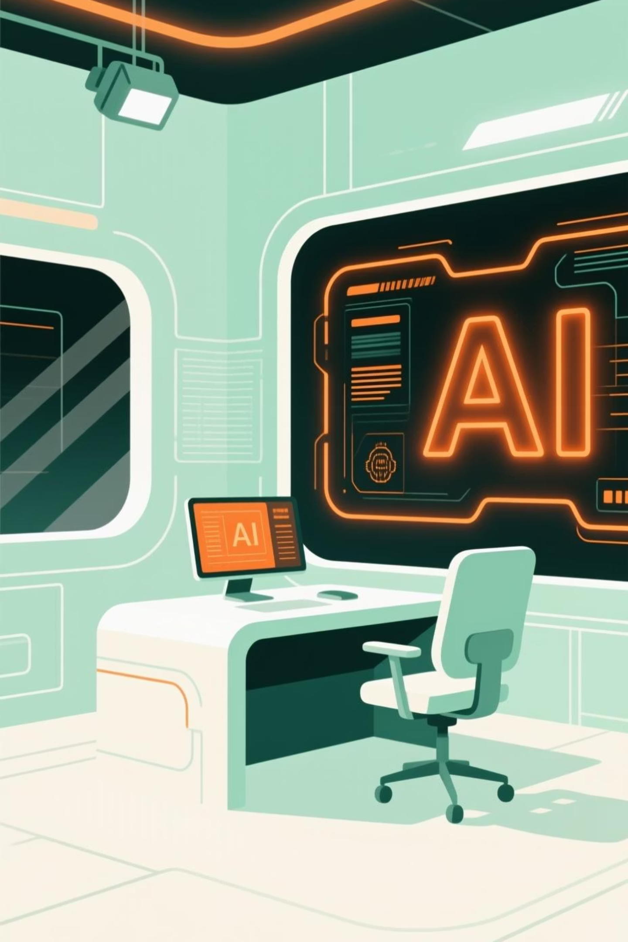
Kling AI: Unleashing Creative Video
Kling AI is an innovative platform leveraging artificial intelligence to generate high-quality video content from text prompts, streamlining the production process.
Visit klingai.com
Input your desired video script or concept.
Select preferred styles and visual elements.
Generate and refine your AI-powered video creation.
Practical Example: Create a short marketing video for a new product launch by simply describing its features and benefits.

Slide 4

Adobe Podcast: Professional Audio Enhancement
Adobe Podcast utilizes AI to dramatically improve audio quality, removing background noise, enhancing speech, and adding studio-like effects with ease.
Access podcast.adobe.com
Upload your raw audio file.
Apply AI-powered enhancements (e.g., noise reduction, speech clarity).
Download your polished, professional-grade audio.
Practical Example: Transform a casually recorded interview into broadcast-ready audio by removing ambient cafe noise.

Slide 5
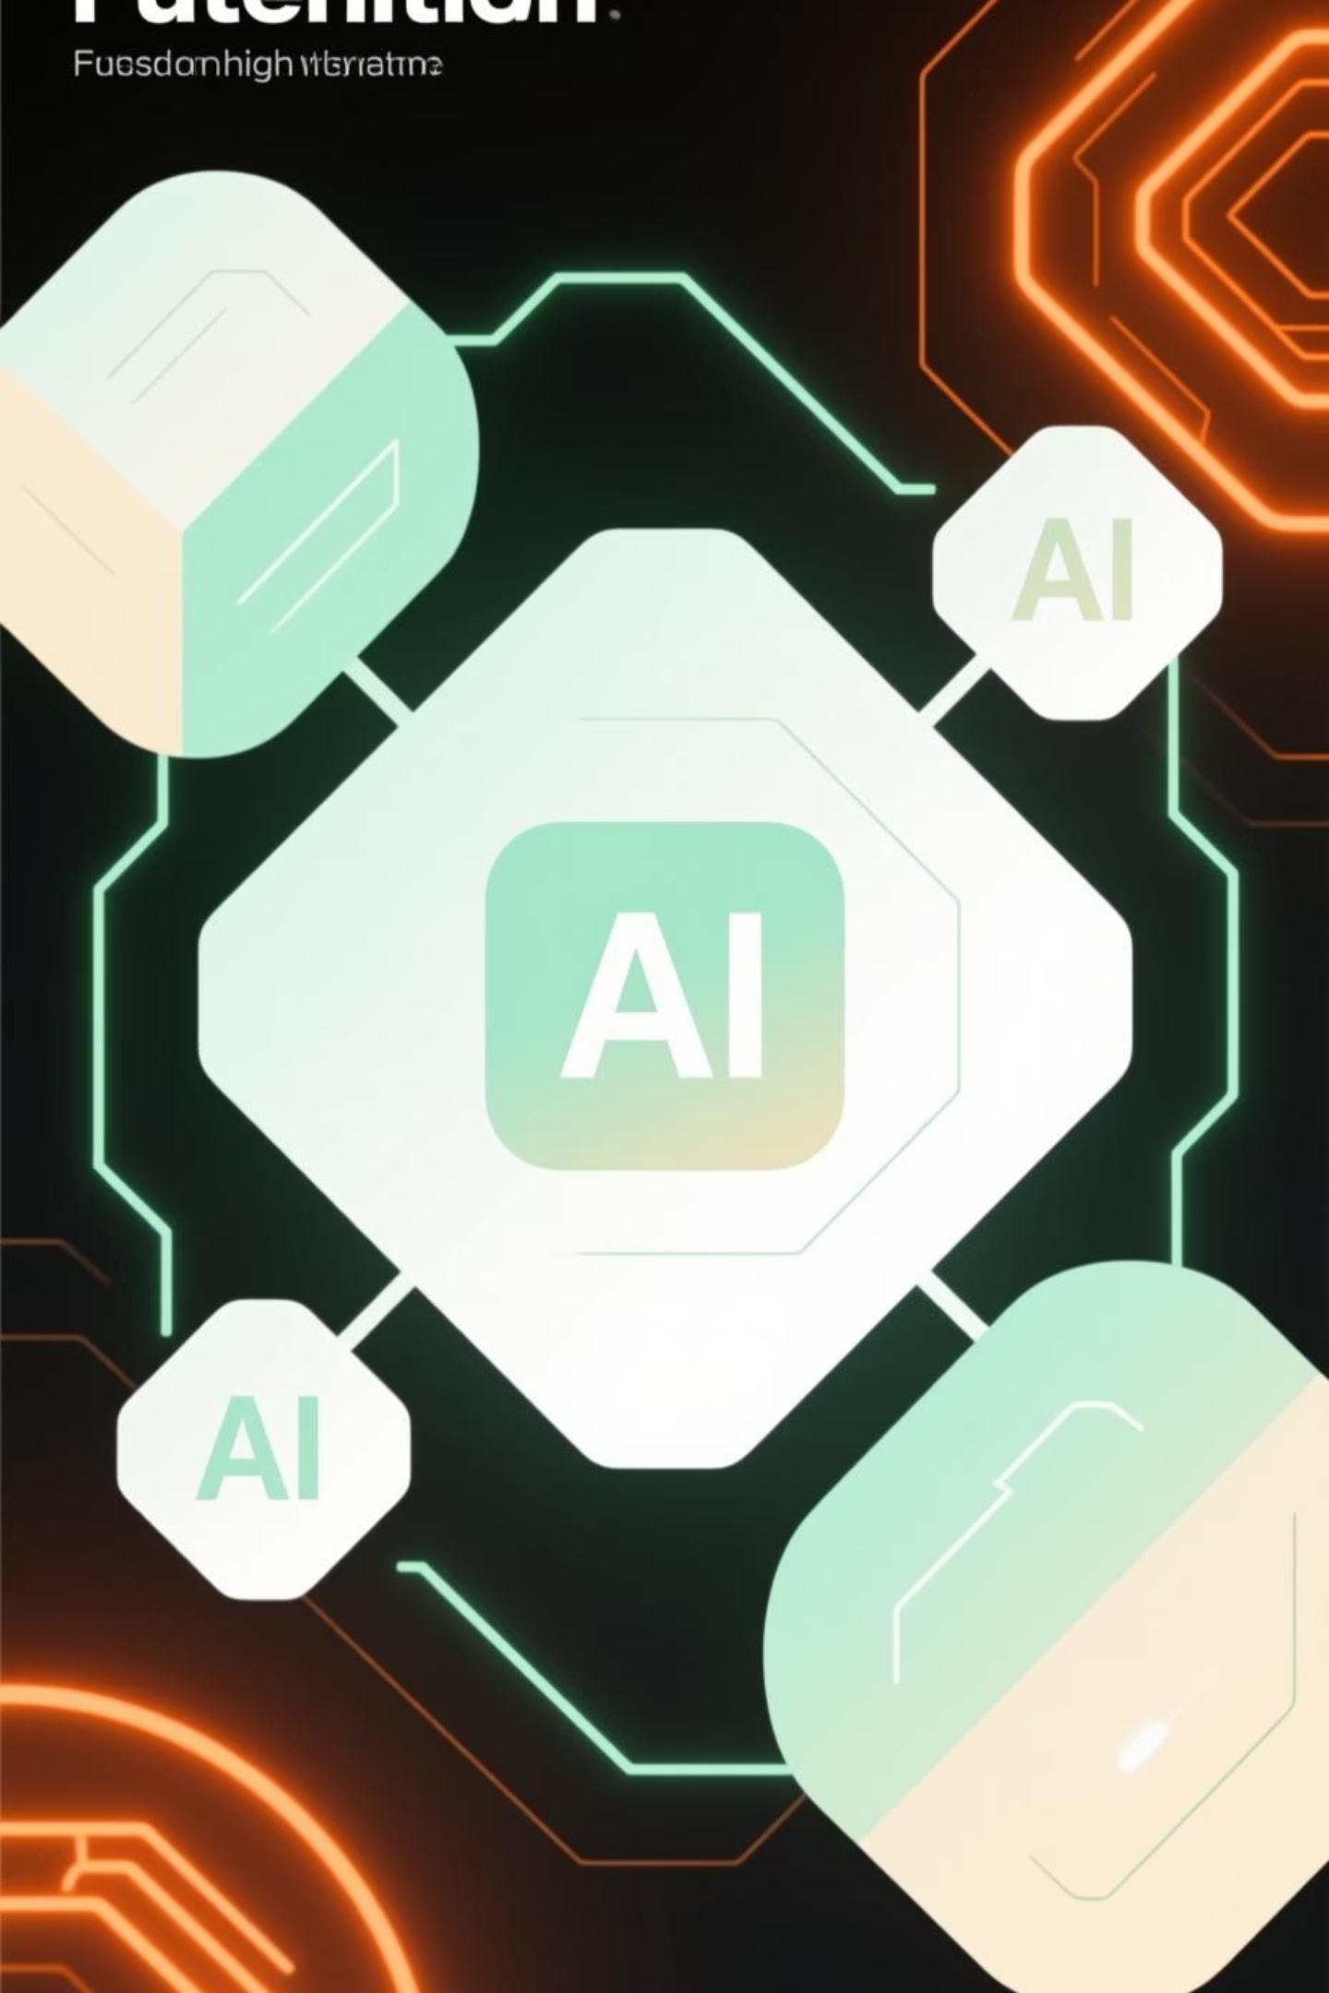
Gamma: Dynamic Presentation Design
Gamma is an AI-powered tool that helps you create stunning, responsive presentations and documents with minimal effort, focusing on visual storytelling.
Go to gamma.app
Enter your content or outline.
Choose from various AI-suggested designs and themes.
Generate and customize your interactive presentation.
Practical Example: Quickly create an engaging academic presentation from your research paper, complete with compelling visuals.

Slide 6
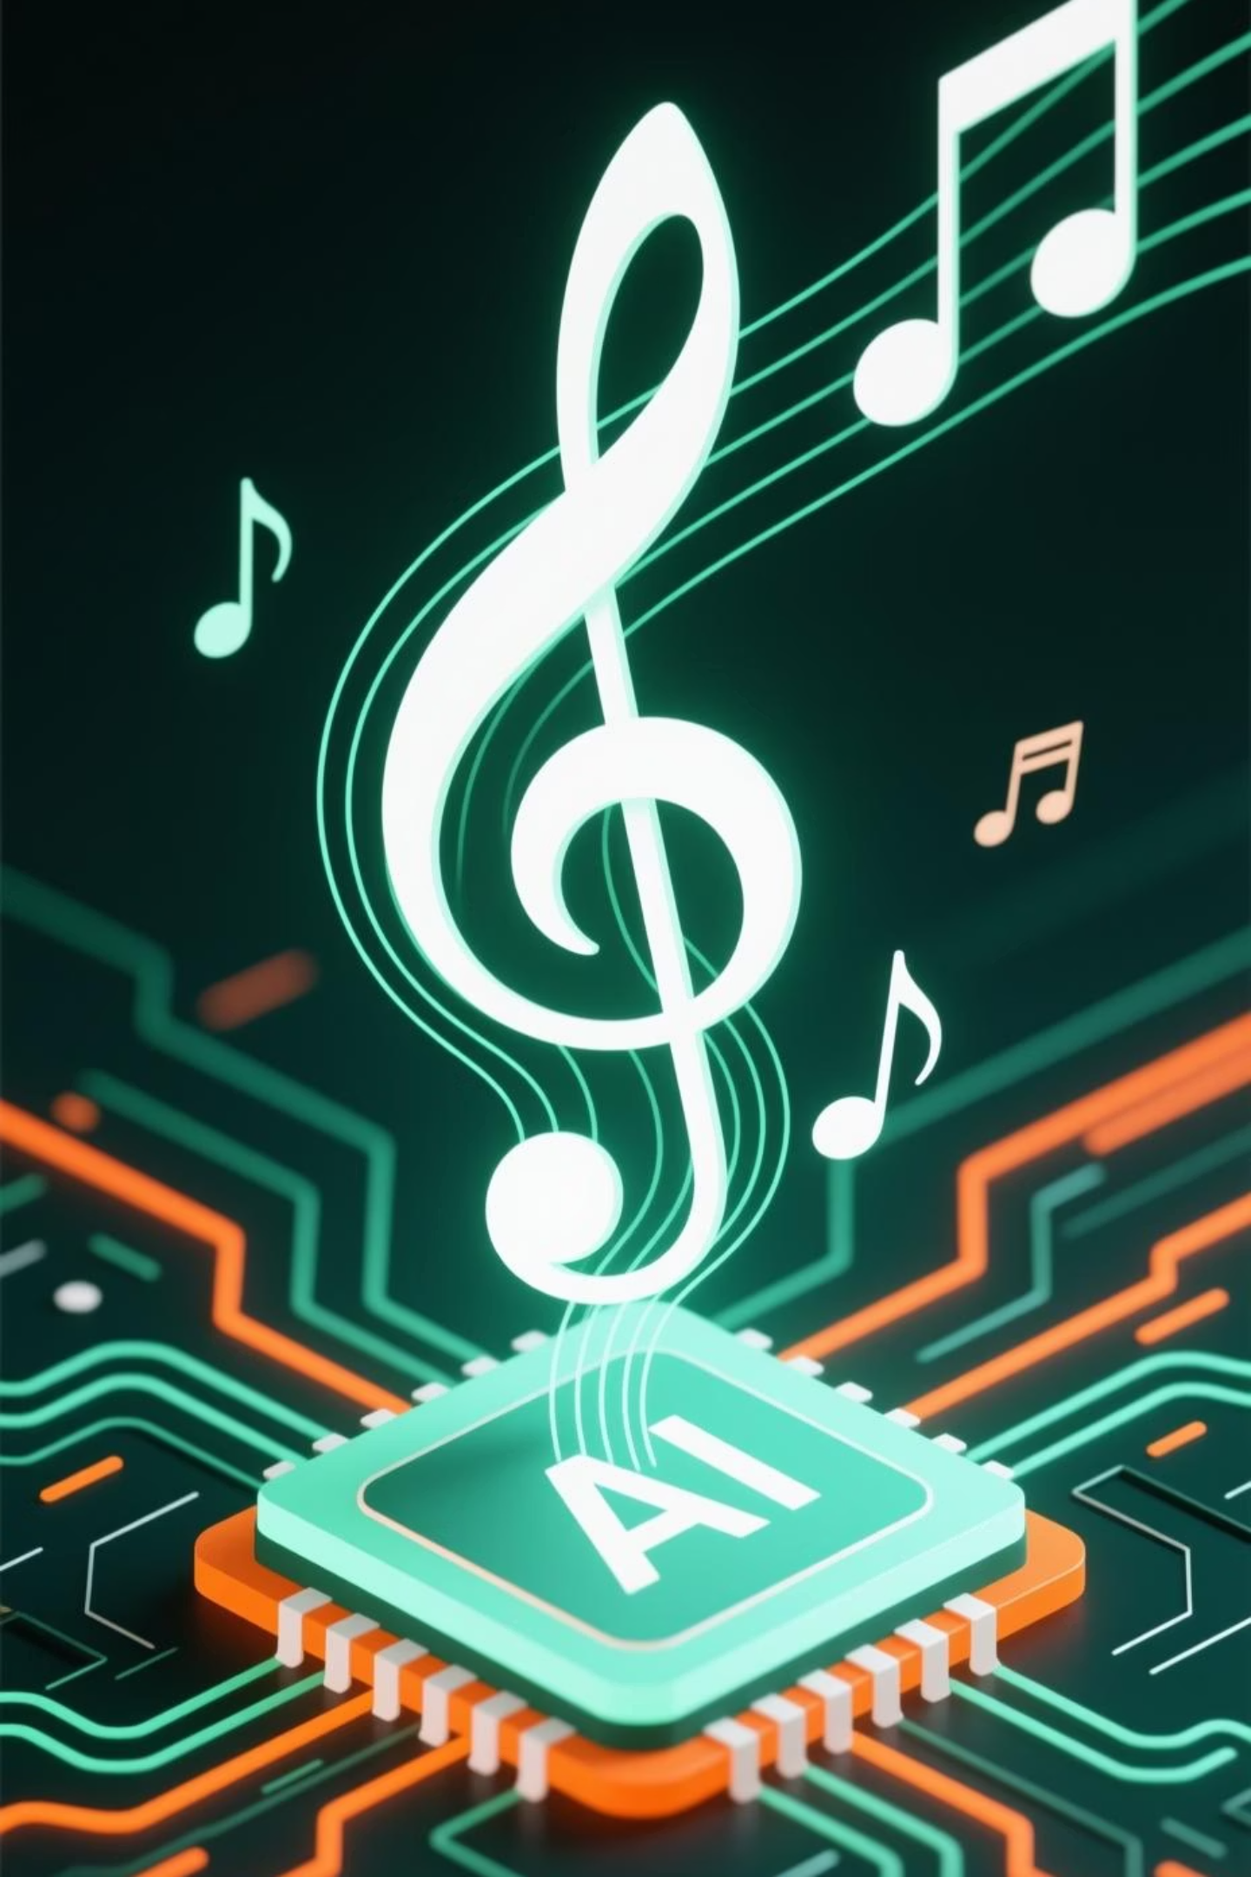
Suno: AI-Generated Music Creation
Suno is an innovative AI platform that allows users to create original songs and musical compositions from simple text descriptions or prompts.
Visit suno.ai
Describe the genre, mood, and instruments you desire.
Generate multiple song variations.
Download or share your unique AI-composed music.
Practical Example: Create a custom background track for your YouTube video or a jingle for a personal project.

Slide 7
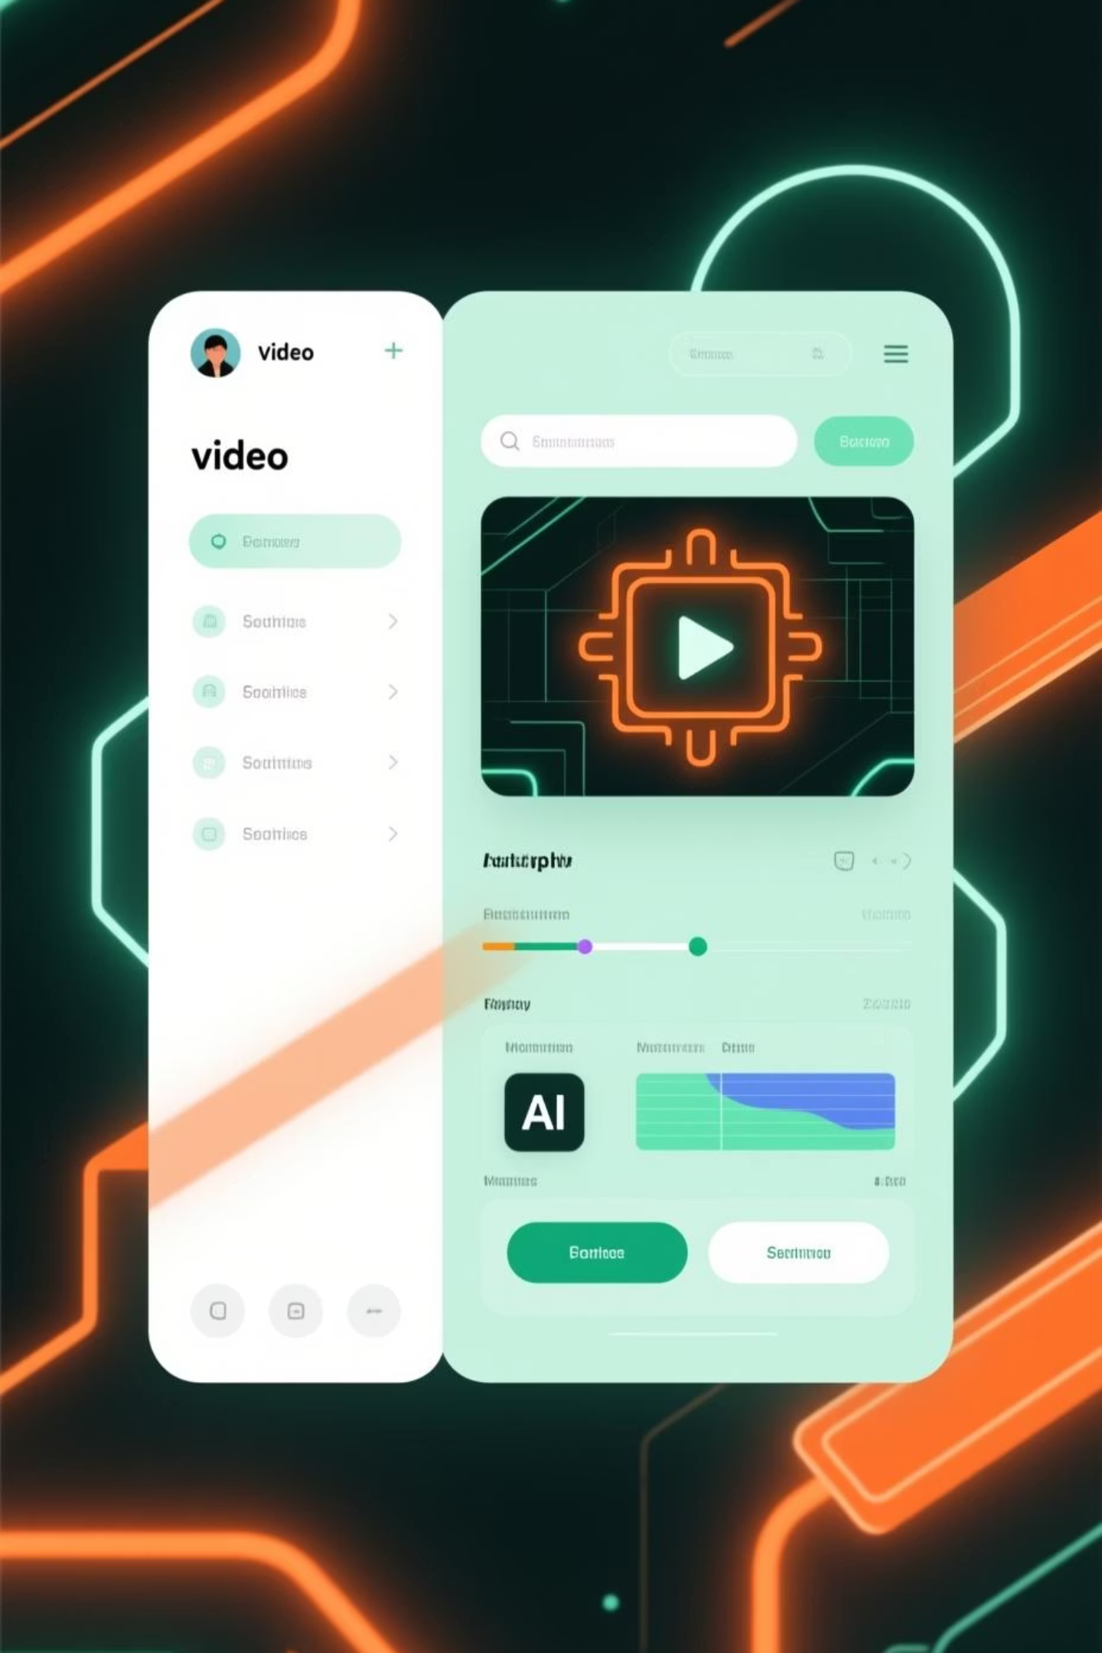
Runway: Advanced Video Editing with AI
Runway offers a suite of AI magic tools for video editing, enabling complex tasks like object removal, green screen, and generating video from text or images.
Log in to runwayml.com
Upload your video footage.
Utilize AI tools for specific editing needs (e.g., motion tracking).
Export your professionally edited video.
Practical Example: Easily remove an unwanted object from a video clip without manual frame-by-frame editing.

Slide 8
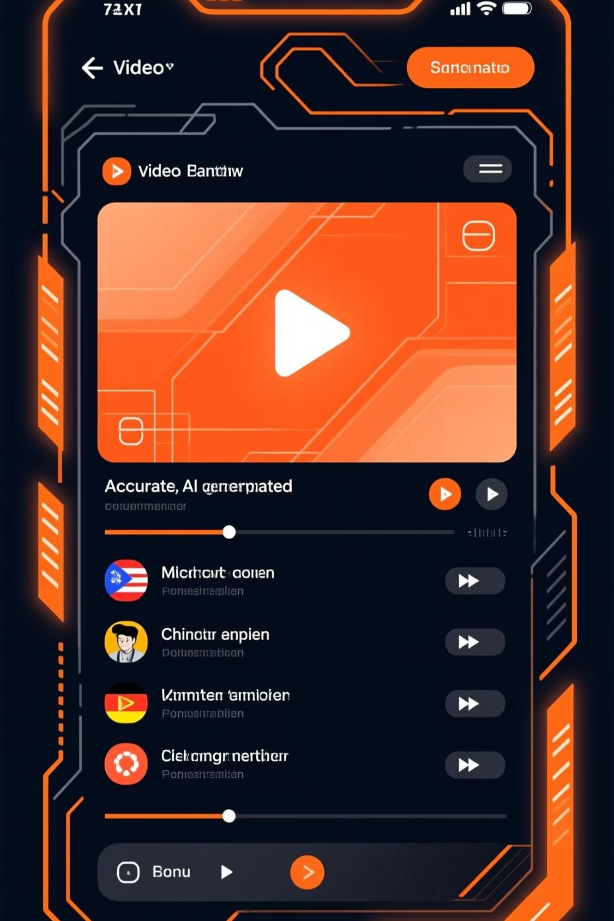
Caption: Instant Subtitles and Accessibility
Caption.ai provides AI-powered real-time and post-production captioning, enhancing video accessibility and reach for diverse audiences.
Upload your video to caption.ai
The AI automatically transcribes and generates captions.
Review and edit any necessary adjustments.
Download captions in various formats or embed directly.
Practical Example: Add accurate subtitles to a lecture recording, making it accessible to hearing-impaired students and international audiences.

Slide 9
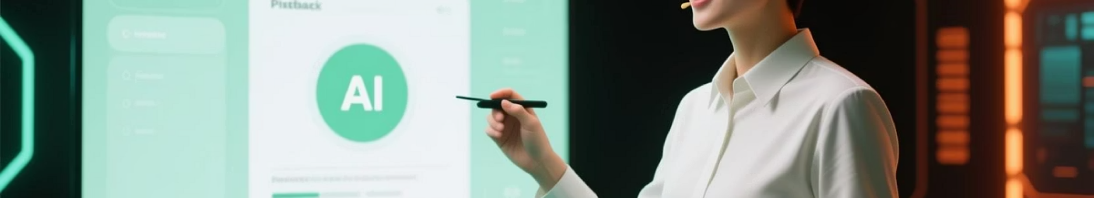
Presenton: AI-Driven Presentation Coaching
Presenton.ai uses AI to analyze your presentation delivery, providing real-time feedback on pacing, tone, body language, and slide design for improvement.
Record your presentation practice session on presenton.ai
Receive detailed AI analysis and actionable insights.
Implement feedback and refine your delivery.
Track progress over multiple practice sessions.
Practical Example: Improve your public speaking skills for an upcoming conference by receiving objective AI-driven coaching.

Slide 10
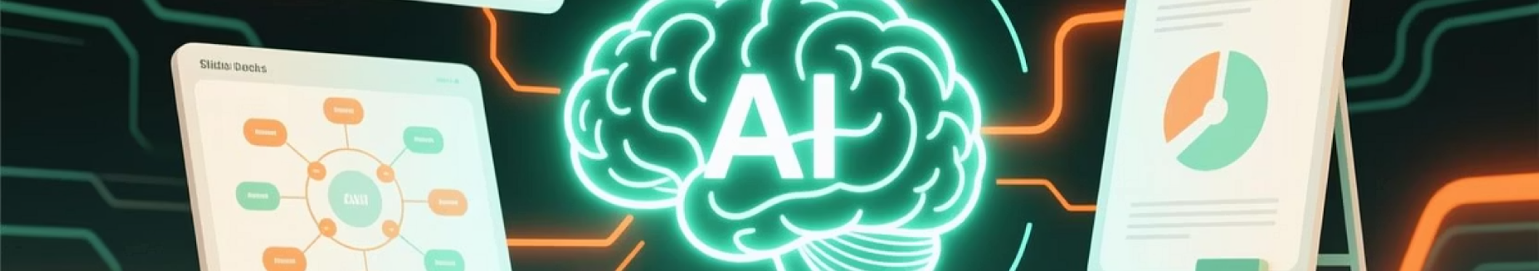
Preswald: Comprehensive Presentation Toolkit
Preswald.ai offers an all-in-one AI platform for presentation creation, including content generation, visual design, and audience engagement features.
Start a new project on preswald.ai
Input your topic and key points for AI content generation.
Select design templates and customize visuals.
Utilize interactive elements for audience participation.
Practical Example: Generate an entire sales pitch presentation, including competitive analysis and market trends, in minutes.

Slide 11

MusicGPT: Contextual Music Generation
MusicGPT.ai specializes in generating context-aware music, perfect for specific moods, scenarios, or accompanying various media types, based on AI's understanding of human preferences.
Access musicgpt.ai
Provide specific parameters for your desired music (e.g., "upbeat, instrumental for studying").
Generate and preview unique musical pieces.
Integrate the generated music into your projects.
Practical Example: Create an inspiring and focus-enhancing instrumental track for a study session or a creative writing project.

Slide 12

Presenton: AI-Driven Presentation Coaching
Presenton.ai uses AI to analyze your presentation delivery, providing real-time feedback on pacing, tone, body language, and slide design for improvement.
Record your presentation practice session on presenton.ai
Receive detailed AI analysis and actionable insights.
Implement feedback and refine your delivery.
Track progress over multiple practice sessions.
Practical Example: Improve your public speaking skills for an upcoming conference by receiving objective AI-driven coaching.

